Slide 1

Web Request Life Cycle
1 in 10 Tenacious
Madujith M A

Slide 2
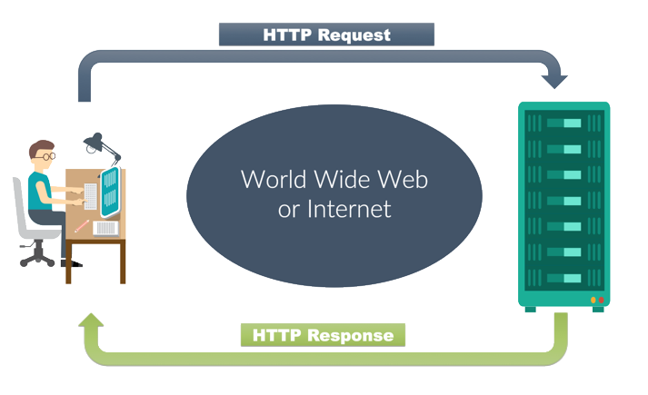
Web Request
A web request is a communicative message that is transmitted between the client, or web browsers, to the servers.
This request is essential in providing the user with the correct and preferred webpages that the server will then display on the user’s interface.
The server then retrieves the content requested by the client that will result in the webpages, images or interactive features displayed.
Per each request sent on behalf of the client, the server will complete each one thus loading the respective amount of webpages, images or elements.

Slide 3
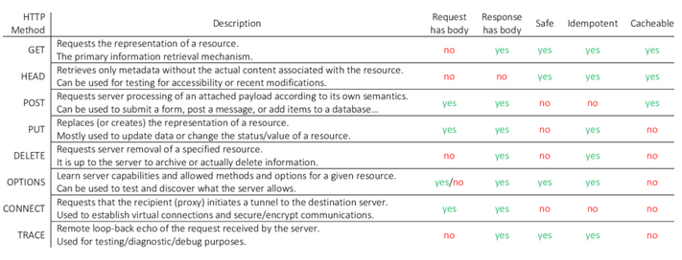
Web Requests Methods
Notes:
This slide is only for the trainer… You can display the poll from GTM and after the poll is taken, share the result, connect the poll result with the topic. Once done, you can hide the poll so that the PPT is visible.
I have created the poll in the GTM webinar.

Slide 4
Types of web requests
Explicit Web request:
A request that is initiated manually by the user.
Implicit Web request:
A request that is initiated transparently by the Web client, without manual intervention on the part of the user, as an ancillary event corresponding to an explicit Web request.
Embedded Web request:
A request for dereferencing a URI embedded within a Web resource manifestation: e.g., following the link in an HTML document, etc.
User-input Web request:
A request for dereferencing a URI supplied by the user directly to the Web client: e.g., typed into the address window, bookmarks, history, etc.

Slide 5
Life Cycle
When the user interacts with the app causes several HTTP request to run parallel. The http request life cycle is described as below:-
Web Browser submits the request to the server after creating a socket in local progress.
The http server waits for the request to come on socket i.e. port-80.
The web browser translates the yahoo.com to an IP address if it does not knows it.
If the web browser does not recognize the address it contacts a DNS Server to resolve the name.
The browser will open a TCP connection to the IP address of yahoo.com and send a HTTP GET request over.
The request is then submitted to DNS server where IP address is fetched based on domain name.
Now the request is submitted to Http Server as per HTTP protocol.
Http server receives the request and shifts the client to another socket.
So the socket on port-80 is released to receive request from other clients.
Web Browser & server both are connected to each other.
The server will process the request, renders the response & breaks the connection.

Slide 6


